Slide 1


Statistic
Lecture 7
Dr. Nada Abdullah Rasheed
Assist prof. / Computer Science

Slide 2
Syllabus Content
Subject | Lec. No.
Pearson Correlation in SPSS | 3
Regression | 7
The Regression Equation | 9

Slide 3
Regression
Univariate regression uses one variable to model changes in another variable, and multivariate regression (multiple regression) uses several variables to model changes in another variable.
In univariate regression there are two variables: a dependent variable (Y), which is also called the regressed variable or predicted variable, is the variable whose values we are predicting; and an independent variable (X), which is also called the regress or variable or predictor variable, is the variable used to model changes in the dependent variable.

Slide 4
Regression
6.2 The Regression Equation
In regression, values of one variable are used to predict values of a second variable. In this procedure you are creating a regression equation of a linear model, which takes this generic form:
Y'=b0+b1X
You should be familiar with this equation, because it is the equation for a straight line, which takes the mathematical form:
y = mx + b

Slide 5
Regression
In the function, the m is a constant representing the change in y for every one-unit change in variable x; b is a constant that is expected when x = 0, and x is the variable used to predict y. Thus, the linear equation is modeling changes in y based on changes in x. For example, say we have the following linear equation, which is based on the data in the table below:
y = 2x + 10

Slide 6
Regression
The value 2 is the predicted change in y for every one-unit change in x, that is, if x increases by 1 then y is predicted to change by 2. The value 10, which was the constant b in the equation above, is the value of y when x = 0. Given this function we could plug in any value of x to calculate values of y. In the table to the right, for each given x, I have the corresponding y values calculated from the function above.

Slide 7
Regression
x | 2x + 10 | y
2 | 2(2) + 10 | 14
3 | 2(3) + 10 | 16
4 | 2(4) + 10 | 18
6 | 2(6) + 10 | 22
8 | 2(8) + 10 | 26
9 | 2(9) + 10 | 28
11 | 2(11) + 10 | 32
12 | 2(12) + 10 | 34
13 | 2(13) + 10 | 36
14 | 2(14) + 10 | 38

Slide 8
Regression
You can see that for every one-unit increase in x (from 2-3 or from 8-9), there is a corresponding two-unit increase in y (from 14-16 and 26-28, respectively). Thus, the value of m in the linear equation (b₁ in the regression equation) can be thought of as the slope of the linear equation. The slope of the linear equation can be better understood by plotting all of the x-y data points in a scatter plot and then drawing a line through them:

Slide 9
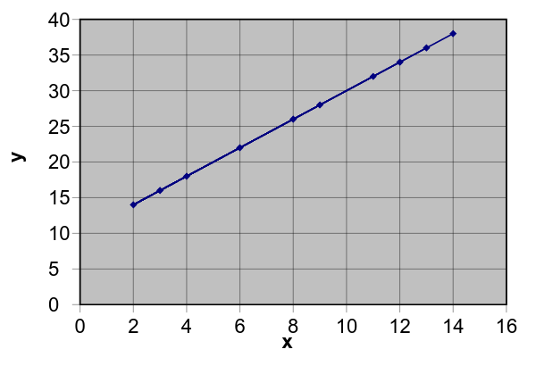
Regression

